Slide 1
Krötensee-Mittelschule Quali 2018 Englisch
Informationsveranstaltung für externe Bewerber

Slide 2
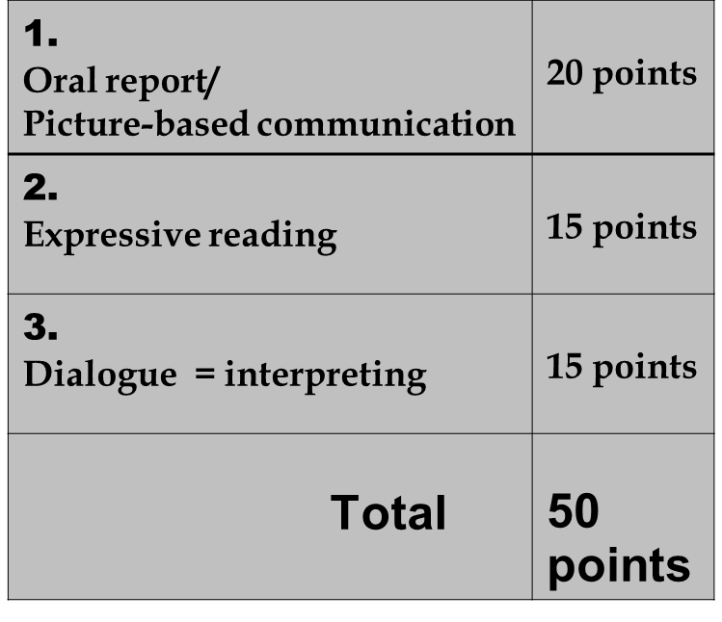
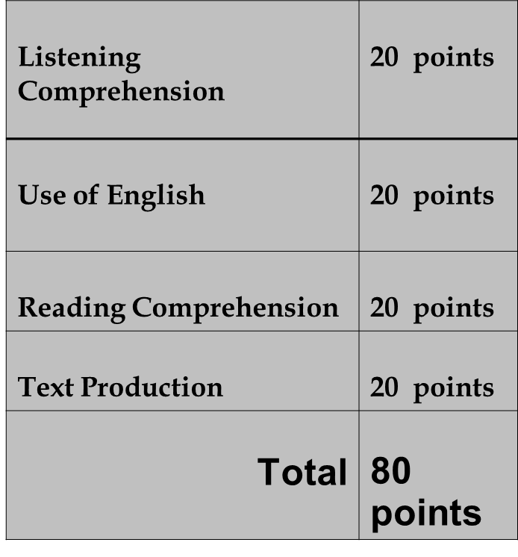
English final exams
1. Oral exam 2. Written exam

Slide 3
1. a) Oral report
Topics: e.g.
A hobby
An English speaking country e.g. Canada
Work experience – ideas for my future job
A famous person in history, sport, social life, etc.

Slide 4
1. a) Oral report
Important:
3 – 4 minutes + some questions
The topic has got something to do with you!
Bring 3 – 4 photos or things about the topic.
No texts from the internet!
Speak in your own words!
Of course – you can use the internet for getting information and pictures.

Slide 5
1. a) Picture-based communication
You have to describe a picture and tell a story.
It will take 5 minutes.

Slide 6
1. b) Expressive Reading
Four texts
Some questions to the texts

Slide 7
1. c) Interpreting
Topics:
Shopping
At a restaurant
At a hotel
Free time activities
Asking the way

Slide 8
2. Written Exam
Listening Comprehension + Use of English
Words – sounds – situations – grammar
30 minutes, 40 points
Reading Comprehension + Text Production
Text Production
Letter/e-mail or
Picture story
60 minutes, 40 points

Slide 9
Times
Oral exam
Thursday, 14th June
15 minutes
Written exam
Monday, 25th June
8.30 – 10.10 a.m.
Your dictionary!

Slide 10
Thank you for listening

Slide 11
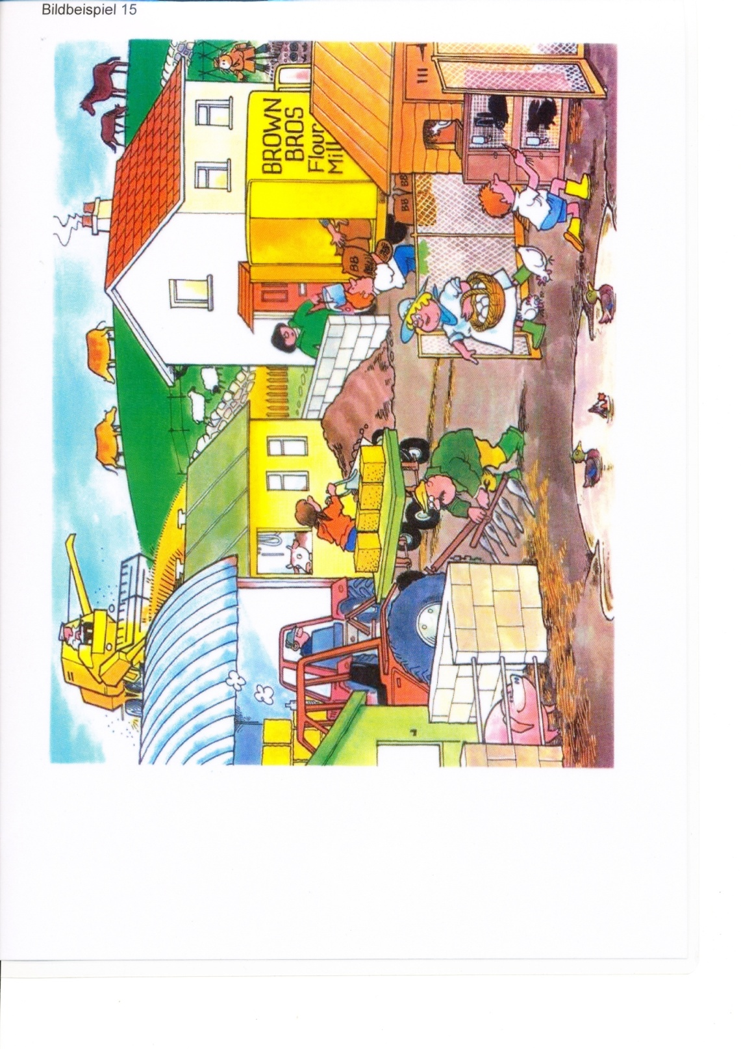
e.g. Picture 1

