Slide 1
Krötensee-Mittelschule Quali 2019 Englisch
Informationsveranstaltung für externe Bewerber

Slide 2
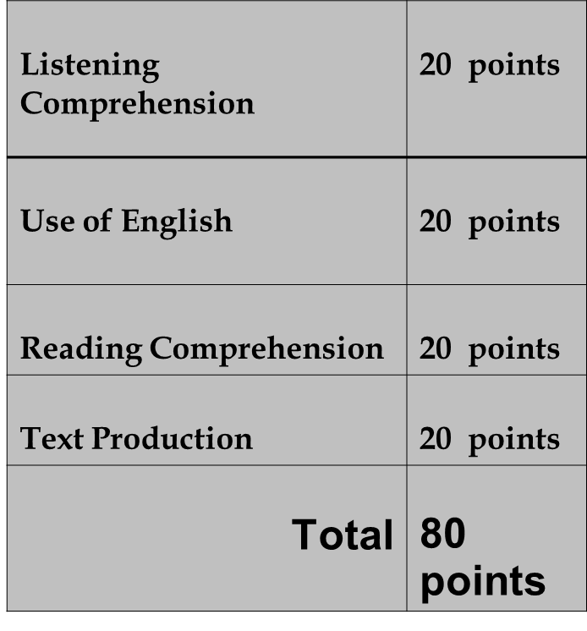
English final exams
1. Oral exam 2. Written exam
Part A | Part B | Part C
Picture-based Interview | Topic-based Talk | Interpreting
5 minutes | 5 minutes | 5 minutes
Preparation time: ½ minute | Preparation time: 1 ½ minutes
15 points | 15 points | 15 points
language 15 points
Total 60 points

Slide 3
1. a) Picture-based Interview
Talk about the picture
Describe what the people are doing
Maybe you talk about the weather
The teacher is going to ask questions

Slide 4
1. b) Topic-based Talk
Mind – map (e.g. Yellowstone-National Park)
Your topic is …
Here are boxes with different aspects.
You have to talk about three of them.
First you have 90 seconds to look at the boxes and to make notes.
Talk for about 2 minutes.

Slide 5
1. c) Interpreting
Topics:
Eating out and cooking
Health problems
Talking about holidays and free time activities
Travelling and public transport (booking, getting information, accommodation, …)
Shopping

Slide 6
2. Written Exam
Listening Comprehension + Use of English
Words – sounds – situations – grammar
30 minutes, 40 points
Reading Comprehension + Text Production
Text Production
Letter/e-mail or
Picture story
60 minutes, 40 points

Slide 7
Times
Oral exam
Monday, 6th May or Tuesday, 7th May or Wednesday 8th May
15 minutes
Written exam
Monday, 1st July
8.30 – 10.10 a.m.
Your dictionary!

Slide 8
Thank you for listening

